Slide 1
18CSE345TIoT Architecture And Protocols
Unit 2

Slide 2
Syllabus
Data Management- Introduction, Managing M2M data: Data generation, Data acquisition, Data validation, Data storage, Data processing, Data remanence, Data analysis, Data management, Business processes in IoT, Everything as a Service (XaaS), M2M and IoT Analytics, Knowledge Management,
Data Link Layer Protocols: PHY/MAC Layer: 3GPP MTC, IEEE 802.11, IEEE 802.15, Wireless HART, Z-Wave, Bluetooth, Bluetooth Low Energy, Zigbee, Zigbee Smart Energy, DASH7

Slide 3
Data management - Introduction:
Some of the key characteristics of M2M data include:
• Big Data: Huge amounts of data are generated, capturing detailed aspects of the processes where devices are involved.
• Heterogeneous Data: The data is produced by a huge variety of devices and is itself highly heterogeneous, differing on sampling rate, quality of captured values, etc.
• Real-World Data: The overwhelming majority of the M2M data relates to real-world processes and is dependent on the environment they interact with.
• Real-Time Data: M2M data is generated in real-time and overwhelmingly can be communicated also in a very timely manner. The latter is of pivotal importance since many times their business value depends on the real-time processing of the info they convey.
• Temporal Data: The overwhelming majority of M2M data is of temporal nature, measuring the environment over time.
• Spatial Data: Increasingly, the data generated by M2M interactions are not only captured by mobile devices, but also coupled to interactions in specific locations, and their assessment may dynamically vary depending on the location.

Slide 4
Polymorphic Data: The data acquired and used by M2M processes may be complex and involve various data, which can also obtain different meanings depending on the semantics applied and the process
they participate in.
Proprietary Data: Up to now, due to monolithic application development, a significant amount of M2M data is stored and captured in proprietary formats. However, increasingly due to the interactions with heterogeneous devices and stakeholders, open approaches for data storage and exchange are used.
Security and Privacy Data Aspects: Due to the detailed capturing of interactions by M2M, analysis of the obtained data has a high risk of leaking private information and usage patterns, as well as compromising security

Slide 5
Managing M2M data
The data flow from the moment it is sensed (e.g. by a wireless sensor node) up to the moment it reaches the backend system has been processed manifold (and often redundantly), either to adjust its representation in
order to be easily integrated by the diverse applications, or to compute on it in order to extract and associate it with respective business intelligence (e.g. business process affected, etc.)
Data generation
Data acquisition
Data validation
Data storage
Data processing
Data remanence
Data analysis

Slide 6
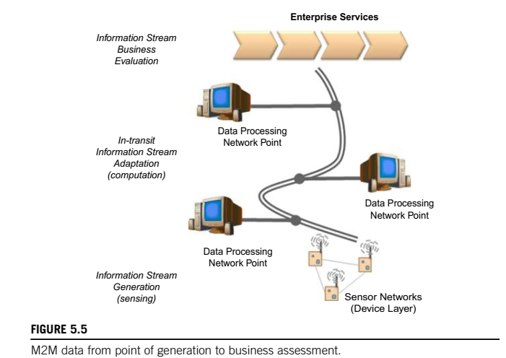
Managing M2M data

Slide 7
Data generation
Data generation is the first stage within which data is generated actively or passively from the device, system, or as a result of its interactions.
The sampling of data generation depends on the device and its capabilities as well as potentially the application needs.
Usually default behaviors for data generation exist, which are usually further configurable to strike a good benefit between involved costs, e.g. frequency of data collection vs. energy used in the case of WSNs, etc.
Not all data acquired may actually be communicated as some of them may be assessed locally and subsequently disregarded, while only the result of the assessment may be communicated.

Slide 8
Data acquisition
Data acquisition deals with the collection of data (actively or passively)from the device, system, or as a result of its interactions .
The data acquisition systems usually communicate with distributed devices over wired or wireless links to acquire the needed data, and need to respect security, protocol, and application requirements.
The nature of acquisition varies, e.g. it could be continuous monitoring, interval-poll, event-based, etc. The frequency of data acquisition overwhelmingly depends on, or is customized by, the application requirements
(or their common denominator).
The data acquired at this stage (for non-closed local control loops) may also differ from the data actually generated. In simple scenarios, due to customized filters deployed at the device, a fraction of the generated data (e.g. adhering to the time of interest or over a threshold) may be communicated.
Additionally, in more sophisticated scenarios, data aggregation and even on-device computation of the data may result in communication of key performance indicators of interest to the application, which are calculated based on a device’s own intelligence and capabilities.

Slide 9
Data validation
Data acquired must be checked for correctness and meaningfulness within the specific operating context. The latter is usually done based on rules, semantic annotations, or other logic.
Data validation in the era of M2M, where the acquired data may not conform to expectations, is a must as
data may be intentionally or unintentionally corrupted during transmission, altered, or not make sense in the business context.
As real-world processes depend on valid data to draw business-relevant decisions, this is a key stage, which sometimes does not receive as much attention as it should.
Several known methods are deployed for consistency and data type checking; for example, imposed range limits on the values acquired, logic checks, uniqueness, correct time-stamping, etc.
In addition, semantics may play an increasing role here, as the same data may have different meanings
in various operating contexts, and via semantics one can benefit while attempting to validate them.
Another part of the validation may deal with fallback actions such as requesting the data again if checks fail, or attempts to “repair” partially failed data.

Slide 10
Data storage
Machines generate an incredible amount of information that is captured and needs to be stored for further processing.
As this is proving challenging due to the size of information, a balance between its business usage vs. storage needs to be considered; that is, only the fraction of the data relevant to a business need may be stored for future reference.
This means, for instance, that in a specific scenario, (usually for on-the-fly data that was used to make a decision) once this is done, the processed result can be stored but not necessarily the original data.
However, one has to carefully consider what the value of such data is to business not only in current processes, but also potentially other directions that may be followed in the future by the company as different assessments of the same data may provide other, hidden competitive advantages in the future.
Due to the massive amounts of M2M data, as well as their envisioned processing (e.g. searching), specialized technologies such as massively parallel processing DBs, distributed file systems, cloud computing platforms,
etc. are needed.

Slide 11
Data processing
Data processing enables working with the data that is either at rest (already stored) or is in-motion (e.g. stream data).
The scope of this processing is to operate on the data at a low level and “enhance” them for future needs.
Typical examples include data adjustment during which it might be necessary to normalize data, introduce an estimate for a value that is missing, re-order incoming data by adjusting timestamps, etc.
Similarly, aggregation of data or general calculation functions may be operated on two or more data streams and mathematical functions applied on their composition.
Another example is the transformation of incoming data; for example, a stream can be converted on the fly (e.g. temperature values are converted from F to C), or repackaged in another data model, etc.
Missing or invalid data that is needed for the specific time-slot may be forecasted and used until, in a future interaction, the actual data comes into the system.
This stage deals mostly with generic operations that can be applied with the aim to enhance them, and takes advantage of low-level (such as DB stored procedures) functions that can operate at massive levels with very low overhead, network traffic, and other limitations.

Slide 12
Data remanence
M2M data may reveal critical business aspects, and hence their lifecycle management should include not only the acquisition and usage, but also the end-of-life of data.
However, even if the data is erased or removed, residues may still remain in electronic media, and may
be easily recovered by third parties often referred to as data remanence.
Several techniques have been developed to deal with this, such as overwriting, degaussing, encryption, and physical destruction.
For M2M, points of interest are not only the DBs where the M2M data is collected, but also the points of action, which generate the data, or the individual nodes in between, which may cache it.
At the current technology pace, those buffers (e.g. on device) are expected to be less at risk since their limited size means that after a specific time has elapsed, new data will occupy that space; hence, the window of opportunity is rather small.
In addition, for large-scale infrastructures the cost of potentially acquiring “deleted” data may be large; hence, their hubs or collection end-points, such as the DBs who have such low cost, may be more at risk.
In light of the lack of cross industry M2M policy-driven data management, it also might be difficult to
not only control how the M2M data is used, but also to revoke access to it and “delete” them from the Internet once shared.

Slide 13
Data analysis
Data available in the repositories can be subjected to analysis with the aim to obtain the information they encapsulate and use it for supporting decision-making processes.
The analysis of data at this stage heavily depends on the domain and the context of the data.
For instance, business intelligence tools process the data with a focus on the aggregation and key performance indicator assessment. Data mining focuses on discovering knowledge, usually in conjunction with predictive goals.
Statistics can also be used on the data to assess them quantitatively (descriptive statistics), find their main characteristics (exploratory data analysis), confirm a specific hypothesis (confirmatory data analysis), discover knowledge (data mining), and for machine learning, etc.
This stage is the basis for any sophisticated applications that take advantage of the information hidden directly or indirectly on the data, and can be used.

Slide 14
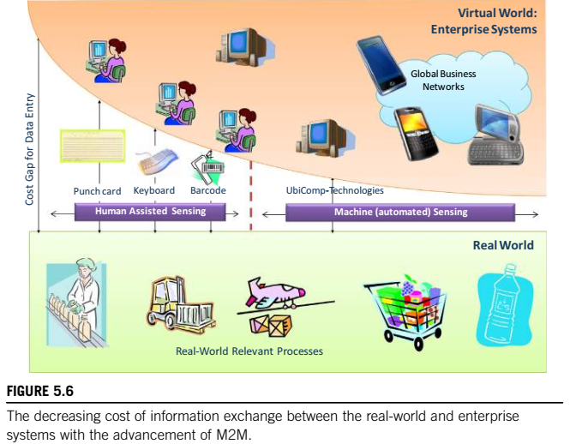
Business processes in IoT
1. Introduction
A business process refers to a series of activities, often a collection of interrelated processes in a logical sequence, within an enterprise, leading to a specific result.

Slide 15
There are several types of business processes such as management, operational, and supporting, all of which aim at achieving a specific mission objective.
As business processes usually span several systems and may get very complex, several methods and techniques have been developed for their modelling, such as the Business Process Model and Notation (BPMN), which graphically represents business processes in a business process model.
Managers and business analysis model an enterprise’s processes in an effort to depict the real way an enterprise operates and subsequently to improve efficiency and quality.
Several key business processes in modern enterprise systems heavily rely on interaction with real-world processes, largely for monitoring, but also for some control (management), in order to take business-critical decisions and optimize actions across the enterprise.

Slide 16
2. IoT integration with enterprise systems
M2M communication and the vision of the IoT pose a new era where billions of devices will need to interact with each other and exchange information in order to fulfil their purpose.
Much of this communication is expected to happen over Internet technologies and tap into the extensive experience acquired with architectures and experiences in the Internet/Web over the last several decades.
More sophisticated, though still overwhelmingly experimental, approaches go beyond simple integration and target more complex interactions where collaboration of devices and systems is taking place.
Cross-layer interaction and cooperation can be pursued:
at the M2M level, where the machines cooperate with each other (machine-focused interactions), as well as
at the machine-to-business (M2B) layer, where machines cooperate also with network-based services, business systems (business service focus), and applications.
These can communicate with each other over short-range protocols (e.g. over ZigBee, Bluetooth), or even longer distances (e.g. over Wi-Fi, etc.).

Slide 17
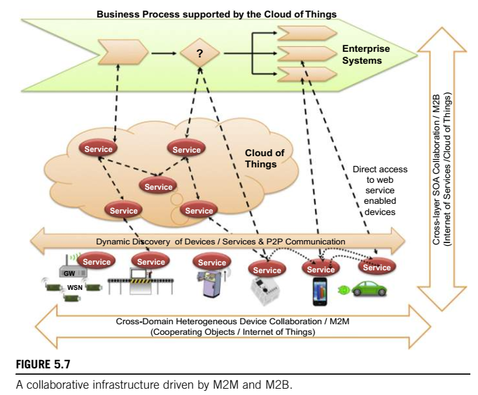
2. IoT integration with enterprise systems

Slide 18
Some of them may host services (e.g. REST services), and even have dynamic discovery capabilities based on the communication protocol or other capabilities (e.g. WS-Eventing in DPWS).
Some of them may be very resource constrained, which means that auxiliary gateways could provide additional support such as mediation of communication, protocol translation, etc. Independent of whether the devices are able to discover and interact with other devices and systems directly or via the support of the
infrastructure, the M2M interactions enable them to empower several applications and interact with each other in order to fulfil their goals.
Promising real-world integration is done using a service-oriented approach by interacting directly with the respective physical elements, for example, via web services running on devices (if supported) or via more
lightweight approaches such as REST.
In the case of legacy systems, gateways and service mediators are in place to enable such integration challenges.
However, in the era of sophisticated networked embedded devices, open interactions, and virtualized resources, a dilemma is emerging which manifests to which functionalities can be abstracted and migrated to the cloud (with all the benefits and constraints it poses), and which of these should still remain on the device itself

Slide 19
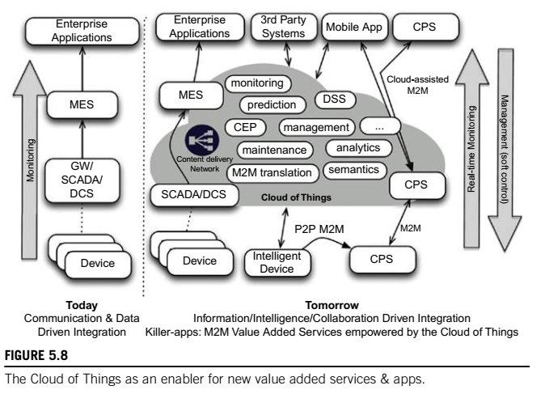
Many of the services that will interact with the devices are expected to be network services available, for example, in the cloud.
The main motivation for enterprise services is to take advantage of the cloud characteristics such as virtualization, scalability, multi-tenancy, performance, lifecycle management, etc. Similarly, we expect to see that a large number of devices, and generally cyber-physical systems, will make their functionality available on the cloud.
As such, we are moving towards an infrastructure where the cloud and its services take a prominent position towards empowering modern enterprises and their business processes.

Slide 20
3. Distributed business processes in IoT
The integration of devices in business processes merely implies the acquisition of data from the device layer, its transportation to the backend systems, its assessment, and once a decision is made, potentially the control (management) of the device, which adjusts its behavior.
However, in the future, due to the large scale of IoT, as well as the huge data that it will generate, such approaches are not viable.
Transportation of data from the “point of action” where the device collects or generates them, all the way to the backend system to then evaluate their usefulness, will not be practical for communication reasons, as well
as due to the processing load that it will incur at the enterprise side;
The first strategic step is to minimize communication with enterprise systems to only what is relevant for business.
With the increase in resources (e.g. computational capabilities) in the network, and especially on the devices themselves (more memory, multi-core CPUs, etc.), it makes sense not to host the intelligence and the computation required for it only on the enterprise side, but actually distribute it on the network, and
even on the edge nodes (i.e. the devices themselves)

Slide 21
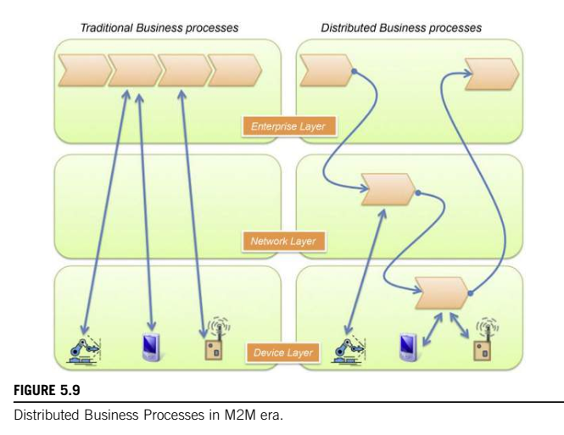

Slide 22
Distributing the computational load in the layers between enterprises and the real-world infrastructure is not the only reason; distributing business intelligence is also a significant motivation.
Business processes can bind during execution of dynamic resources that they discover locally, and integrate them to better achieve their goals.

Slide 23
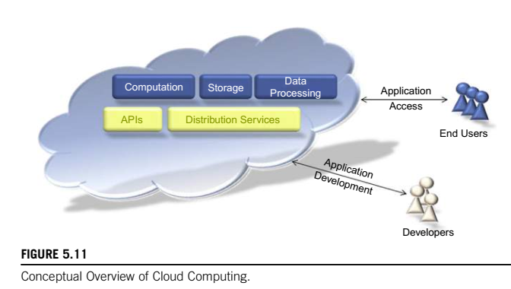
Everything as a service (XaaS)
Cloud computing is a model for enabling ubiquitous, on-demand network access to a shared pool of configurable computing resources (e.g. networks, servers, storage, applications, and services) that can be provisioned, configured, and made available with minimal management effort or service provider interaction.
Cloud computing, however, does not change the fundamentals of software engineering. All applications need access to three things: compute, storage, and data processing capacities. With cloud computing, a fourth
element is added distribution services i.e. the manner in which the data and computational capacity are linked together and coordinated

Slide 24
Several essential characteristics of cloud computing have been defined by NIST (2011) as follows:
On-Demand Self-Service. A consumer can unilaterally provision computing capabilities, such as server time and network storage, as needed, or automatically, without requiring human interaction with each service provider.
Broad Network Access. Capabilities are available over the network and accessed through standard mechanisms that promote use by heterogeneous thin or thick client platforms (e.g. mobile phones, tablets, laptops, and workstations).
Resource Pooling. The provider’s computing resources are pooled to serve multiple consumers using a multi-tenant model, with different physical and virtual resources dynamically assigned and reassigned according to consumer demand. There is a sense of location independence in that the customer generally has no control or
knowledge over the exact location of the provided resources, but may be able to specify location at a higher level of abstraction (e.g. country, state, or datacenter). Examples of resources include storage, processing,
memory, and network bandwidth.
Rapid Elasticity. Capabilities can be elastically provisioned and released, in some cases automatically, to scale rapidly outward and inward commensurate with demand. To the consumer, the capabilities available for provisioning often appear to be unlimited, and can be appropriated in any quantity at any time.
Measured Service. Cloud systems automatically control and optimize resource use by leveraging a metering capability, at some level of abstraction, appropriate to the type of service (e.g. storage, processing, bandwidth, and active user accounts). Resource usage can be monitored, controlled, and reported, providing transparency for both the provider and consumer of the utilized service.

Slide 25
For M2M and IoT, these infrastructures provide the following:
1. Storage of the massive amounts of data that sensors, tags, and other “things” will produce.
2. Computational capacity in order to analyze data rapidly and cheaply.
3. Over time, cloud infrastructure will allow enterprises and developers to share datasets, allowing for rapid creation of information value chains
The three main service models may be defined as (NIST 2011):
Software as a Service (SaaS): Refers to software that is provided to consumers on demand, typically via a thin client. The end-users do not manage the cloud infrastructure in any way. This is handled by an
Application Service Provider (ASP) or Independent Software Vendor (ISV). Examples include office and messaging software, email, or CRM tools housed in the cloud. The end-user has limited ability to change
anything beyond user-specific application configuration settings.
Platform as a Service (PaaS): Refers to cloud solutions that provide both a computing platform and a solution stack as a service via the Internet. The customers themselves develop the necessary software
using tools provided by the provider, who also provides the networks, the storage, and the other distribution services required.
Infrastructure as a Service (IaaS): In this model, the provider offers virtual machines and other resources such as hypervisors (e.g. Xen, KVM) to customers. Pools of hypervisors support the virtual machines
and allow users to scale resource usage up and down in accordance with their computational requirements. Users install an OS image and application software on the cloud infrastructure. The provider manages
the underlying cloud infrastructure, while the customer has control over OS, storage, deployed applications, and possibly some networking components.

Slide 26
Deployment Models:
1. Private Cloud. The cloud infrastructure is provisioned for exclusive use by a single organization comprising multiple consumers (e.g. business units). It may be owned, managed, and operated by the organization, a third party, or some combination of them, and it may exist on or off premises.
2. Community Cloud. The cloud infrastructure is provisioned for exclusive use by a specific community of consumers from organizations that have shared concerns (e.g. mission, security requirements, policy, and compliance considerations). It may be owned, managed, and operated by one or more of the organizations
in the community, a third party, or some combination of them, and it may exist on or off premises.
3. Public Cloud. The cloud infrastructure is provisioned for open use by the general public. It may be owned, managed, and operated by a business, academic, or government organization, or some combination thereof. It exists on the premises of the cloud provider.
4. Hybrid Cloud. The cloud infrastructure is a composition of two or more distinct cloud infrastructures (private, community, or public) that remain unique entities, but are bound together by standardized or proprietary technology that enables data and application portability (e.g. cloud bursting for load balancing between clouds).

Slide 27
M2M and IoT analytics
Introduction
Traditionally, M2M data has been sent from specific devices to specific services, which store the data of interest.
This approach uses semantically well-defined data for specific purposes, and only requires storing the data that is needed for the explicit use cases, and only for as long as it’s required. For the most part, the applications have been monitoring, reporting, and rule-based actions.
The opportunities of using M2M data for advanced analytics and business intelligence are very promising. By transforming raw data into actionable intelligence, it’s possible to improve many areas, such as enhancement of existing products, cost-savings, service quality, as well as operational efficiency.
By applying technologies from the Big Data domain, it is possible to store more data, such as contextual and situational information, and given a more open approach to data, such as the open-data government initiatives (e.g. Data.gov and Data.gov.uk), even more understanding can be derived

Slide 28
Purposes and considerations
Regardless of whether you call it statistics, data mining, or machine learning, there exist a multitude of methods to extract different types of information from data. The information can be used in everything from static reports to interactive decision support systems, or even fully automated real-time systems.
Some examples of methods and purposes are as follows:
1. Descriptive Analytics: Use of means, variances, maxima, minima, aggregates, and frequencies, optionally grouped by selected characteristics.
• Create Key Performance Indicators (KPI’s) that enable better understanding of the performance of complex systems such as cellular networks or oil pipelines.
2. Predictive Analytics: Use current and historical facts to predict what will happen next.
• Forecast demand and supply in a power grid and train a model to predict how price affects electric usage to optimize the performance and minimize peaks in the electricity consumption.
• Understand how electricity and water consumption relates to regional demographics.
• Model the effects of traffic lights on a city’s road network based on data from cars and sensors in the city to minimize congestion.

Slide 29
3. Clustering: Identification of groups with similar characteristics.
• Perform customer segmentation or find behavioral patterns in a large set of M2M devices.
• Mine time series data for recurring patterns that can be used in predictive analytics to detect, for example, fraud, machine failures, or traffic accidents.
4. Anomaly Detection:
• Detect fraud for smart meters by checking for anomalous electricity consumption compared to similar customers, or historic consumption for the subscriber.
M2M data fulfills all the characteristics of Big Data, which is usually described by the four “Vs”:
• Volume: To be able to create good analytical models it’s no longer enough to analyze the data once and then discard it. Creating a valid model often requires a longer period of historic data. This means that the amount of historic data for M2M devices is expected to grow rapidly.
• Velocity: Even though M2M devices usually report quite seldom, the sheer number of devices means that the systems will have to handle a huge number of transactions per second. Also, often the value of M2M
data is strongly related to how fresh it is to be able provide the best actionable intelligence, which puts requirements on the analytical platform

Slide 30
• Variation: Given the multitude of device types used in M2M, it’s apparent that the variation will be very high. This is further complicated by the use of different data formats as well as different configurations for devices of the same type (e.g. where one device measures temperature in Celsius every minute, another device measures
it in Fahrenheit every hour). The upside is that the data is expected to be semantically well-defined, which allows for simple transformation rules.
• Veracity: It’s imperative that we can trust the data that is analyzed. There are many pitfalls along the way, such as erroneous timestamps, non-adherence to standards, proprietary formats with missing semantics, wrongly calibrated sensors, as well as missing data. This requires rules that can handle these cases, as well as fault-tolerant algorithms that, for example, can detect outliers (anomalies)

Slide 31
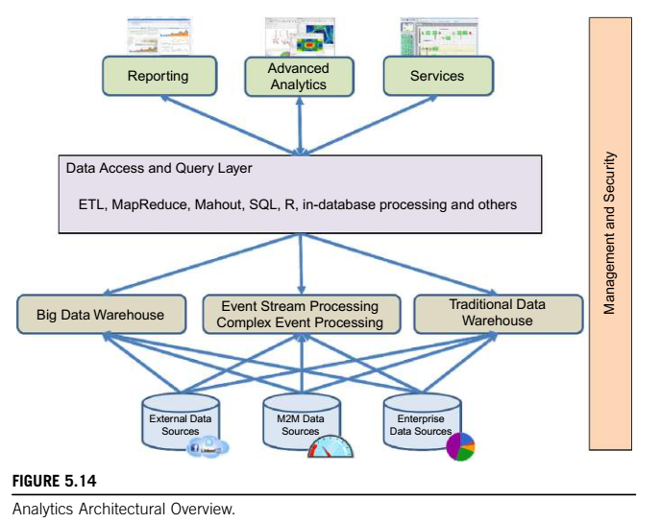
Analytics architecture

Slide 32
Analytics architecture
An analytical architecture should preferably also provide:
• Authentication and authorization to access data.
• Failover and redundancy features.
• Management facilities.
• Efficient batch loading of data and support self-service.
• Scheduling of batch jobs, such as data import and model training.
• Connectors to import data from external sources.
There exist a number of technologies that provide further abstraction levels, such as:
• HBase: A column-oriented data store that provides real-time read/write access to very large tables distributed over HDFS.
• Mahout: A distributed and scalable library of machine learning algorithms that can make use of MapReduce.
• Pig: A tool for converting relational algebra scripts into MapReduce jobs that can read data from HDFS and HBase.
• Hive: Similar to Pig, but offers an SQL-like scripting language called HiveQL instead.
• Impala: Offers low-latency queries using HiveQL for interactive exploratory analytics, as compared to Hive, which is better suited for long running batch-oriented tasks.

Slide 33
Methodology
Knowledge discovery and analytics can be described as a project methodology, following certain steps in a process model. To perform efficient analytics and find answers to important questions, it’s paramount to
involve the right people with the necessary business understanding at the beginning of a project.
When the goals have been understood, the next step is to gather the necessary data and to understand it in terms of characteristics and quality.
Before a model is deployed in the organization, it’s also important to evaluate the performance of the model,
i.e. How well does it fare in the real world?
A model that has been developed can be used in a multitude of scenarios, such as an executive performing Enterprise Performance Management, information consumers using fixed reports, or an automated process deciding on individual transactions using a knowledge-driven business process.
There exist several process models that include some or all parts of the steps mentioned above, such as the Knowledge Discovery in Databases (KDD) process, or the industrial standards Sample, Explore, Modify,
Model and Assess (SEMMA), and Cross Industry Standard Process for Data Mining (CRISP-DM).
The most commonly used process model of these is CRISP-DM (Kdnuggets 2007)

Slide 34
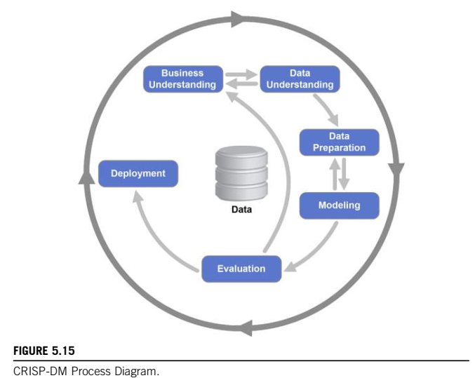

Slide 35
Knowledge management
Firstly, we must look at the concept of knowledge, which in every day usage relates to information, understanding, or skill you get from experience or education. Within the context of ICT systems, the term “knowledge” mostly arises from the application of two other concepts: data and information
1. Data, information, and knowledge
Data: Data refers to “unstructured facts and figures that have the least impact on the typical manager” (Thierauf 1999). With regards to IoT solutions, however, data includes both useful and irrelevant or redundant facts, and in order to become meaningful, needs to be processed.
Information: Within the context of IoT solutions, information is data that has been contextualized, categorized, calculated, and condensed (Davenport & Prusak 2000). This is where data has been carefully curated to provide relevance and purpose (Bali et al. 2009) for the decisionmakers in question. The majority of ICT solutions can be viewed as either storing information or processing data to become information.
Knowledge: Knowledge, meanwhile, relates to the ability to understand the information presented, and using existing experience, the application of it within a certain decision-making context.

Slide 36
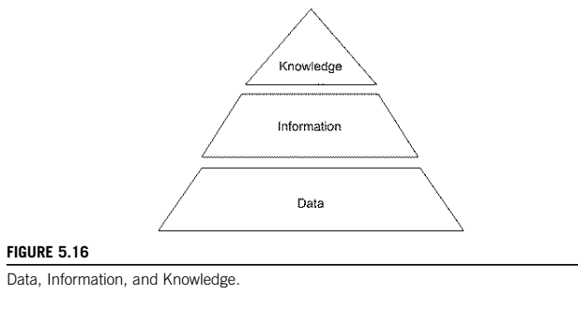

Slide 37
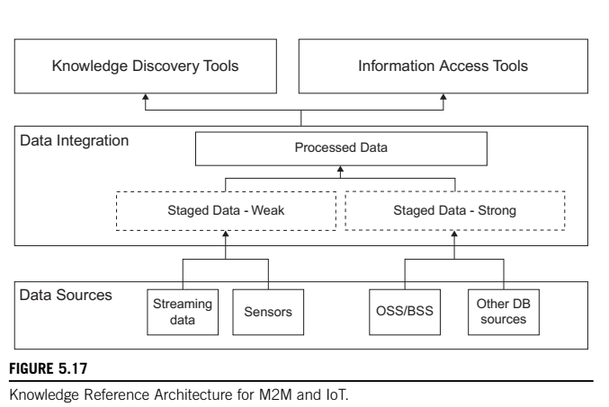
2. A knowledge management reference architecture

Slide 38
There are three levels to the diagram: (1) data sources, (2) data integration, and (3) knowledge discovery and information access.
1 Data sources
Data sources refer to the broad variety of sources that may now be available to build enterprise solutions.
2 Data integration
The data integration layer allows data from different formats to be put together in a manner that can be used by the information access and knowledge discovery tools.
2.1 Staged Data: Staged data is data that has been abstracted to manage the rate at which it is received by the analysis platform. Essentially, “staged data” allows the correct flow of data to reach information access and knowledge discovery tools to be retrieved at the correct time.
2.2 Strong Type Data: Strong type data refers to data that is stored in traditional database formats, i.e. it can be extracted into tabular format and can be subjected to traditional database analysis techniques. Strong data
types often have the analysis defined beforehand, e.g. by SQL queries written by developers towards a database.
2.3 Weak Type Data: Weak type data is data that is not well structured according to traditional database
techniques. Examples are streaming data or data from sensors.

Slide 39
3. Processed data
Processed data is combined data from both strong and weak typed data that has been combined within an IoT context to create maximum value for the enterprise in question. There are various means by which to do this
processing from stripping data separately and creating relational tables from it or pooling relevant data together in one combined database for structured queries.
3. Retrieval layer
Once data has been collated and processed, it is time to develop insights from the data via retrieval. This can be of two main forms: Information Access and Knowledge Discovery.
3.1 Information access tools
Information access relates to more traditional access techniques involving the creation of standardized reports from the collation of strong and weak typed data. Information access essentially involves displaying the data in a form that is easily understandable and readable by end users. A variety of information access tools exist, from SQL visualization to more advanced visualization tools.
3.2 Knowledge discovery tools
Knowledge Discovery, meanwhile, involves the more detailed use of ICT in order to create knowledge, rather than just information, from the data in question. Knowledge Discovery means that decisions may be able to be
taken on such outputs

Slide 40
Data Link Layer Protocols: PHY/MAC layer
3GPP MTC: THIRD-GENERATION PARTNERSHIP PROJECT SERVICE
REQUIREMENTS FOR MACHINE-TYPE COMMUNICATIONS
Machine-type communication (MTC) is a form of data communication which involves one or more entities that do not necessarily need human interaction.
Current mobile networks are optimized for human-to-human (H2H) traffic and not for M2M/MTC interactions; hence, optimizations for MTC are advantageous. For example, one needs lower costs to reflect lower MTC ARPUs (average revenue per user); also, there is a need to support triggering. Hence, 3GPP has started work on M2M specification in 2010 for interoperable solutions, particularly in the 3G/4G/LTE
context.

Slide 41
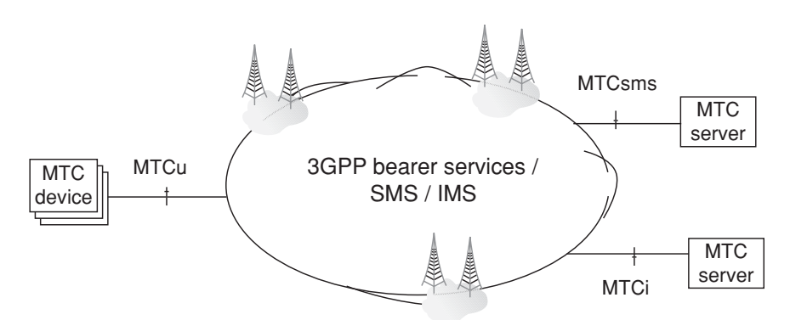
(i) MTC devices communicating with one or more MTC server;
(ii) MTC devices communicating with each other.
In that architecture, the interfaces are as follows:
MTCu: provides MTC devices access to the 3GPP network for the transport of user traffic;
MTCi: the reference point for MTC server to connect the 3GPP network via 3GPP bearer service; and
MTCsms: the reference point for MTC server to connect the 3GPP network via 3GPP SMS.

Slide 42
The following MTC features have been defined:
– Low mobility
– Time controlled
– Time tolerant
– Packet switched (PS) only (here the MTC feature PS only is intended for use with MTC devices that only require packet switched services)
– Small data transmissions
– Mobile originated only
– Infrequent mobile terminated
– MTC monitoring
– Priority alarm
– Secure connection
– Location-specific trigger
– Network provided destination for uplink data
– Infrequent transmission

Slide 43
IEEE 802.15.4
IEEE 802.15.4 is the most commonly used IoT standard for MAC. It defines a frame format, headers including source and destination addresses, and how nodes can communicate with each other.
The frame formats used in traditional networks are not suitable for low power multi-hop networking in IoT due to their overhead. In 2008, IEEE802.15.4e was created to extend IEEE802.15.4 and support low power communication.
It uses time synchronization and channel hopping to enable high reliability, low cost and meet IoT communications requirements.
Its specific MAC features can be summarized as follows [802.15.4]:
Slot frame Structure: IEEE 802.15.4e frame structure is designed for scheduling and telling each node what to do. A node can sleep, send, or receive information. In the sleep mode, the node turns off its radio to save power and stores all messages that it needs to send at the next transmission opportunity. When transmitting, it sends its data and waits for an acknowledgment. When receiving, the node turns on its radio before the scheduled receiving time, receives the data, sends an acknowledgement, turn off its radio, delivers the data to the upper layers and goes back to sleep.
Scheduling: The standard does not define how the scheduling is done but it needs to be built carefully such that it handles mobility scenarios. It can be centralized by a manager node which is responsible for building the schedule, informing others about the schedule and other nodes will just follow the schedule.

Slide 44
PHY/MAC layer
Synchronization: Synchronization is necessary to maintain nodes’ connectivity to their neighbors and to the gateways. Two approaches can be used: acknowledgment-based or frame-based synchronization. In acknowledgement-based mode, the nodes are already in communication and they send acknowledgment for reliability guarantees, thus can be used to maintain connectivity as well. In frame-based mode, nodes are not communicating and hence, they send an empty frame at pre-specified intervals (about 30 second typically).
Channel Hopping: IEEE802.15.4e introduces channel hopping for time slotted access to the wireless medium. Channel hopping requires changing the frequency channel using a pre-determined random sequence. This introduces frequency diversity and reduces the effect of interference and multi-path fading. Sixteen channels are available which adds to network capacity as two frames over the same link can be transmitted on different frequency channels at the same time.
Network formation: Network formation includes advertisement and joining components. A new device should listen for advertisement commands and upon receiving at least one such command, it can send a join request to the advertising device. In a centralized system, the join request is routed to the manger node and processed there while in distributed systems, they are processed locally. Once a device joins the network and it is fully functional, the formation is disabled and will be activated again if it receives another join request.

Slide 45
PHY/MAC layer
IEEE 802.11 AH
IEEE 802.11ah is a light (low-energy) version of the original IEEE 802.11 wireless medium
access standard. It has been designed with less overhead to meet IoT requirements. IEEE 802.11
standards (also known as Wi-Fi) are the most commonly used wireless standards. They have
been widely used and adopted for all digital devices including laptops, mobiles, tablets, and
digital TVs. However, the original WiFi standards are not suitable for IoT applications due to
their frame overhead and power consumption. Hence, IEEE 802.11 working group initiated
802.11ah task group to develop a standard that supports low overhead, power friendly
communication suitable for sensors and motes [Park15]. The basic 802.11ah MAC layer features
Include:
Synchronization Frame: A station is not allowed to transmit unless it has valid medium information that allows it to capture the medium and stop packet exchange by others. It can know such information if it receives the duration field packet correctly. If it does not receive it correctly, then it should wait for a duration called Probe Delay. Probe Delay can be configured by the access points in 802.11ah and announced by transmitting a synchronization frame at the beginning of the time slot.

Slide 46
Efficient Bidirectional Packet Exchange: This feature allows the sensor device to save more power by allowing both uplink and downlink communication between the access point and the sensor and allowing it to go to sleep as soon as it finishes the communication.
Short Mac Frame: The normal IEEE 802.11 frame is about 30 bytes, which is too large for IoT applications. IEEE 802.11ah mitigates this problem by defining a short MAC frame with about 12 bytes.
Null Data Packet: In IEEE 802.11 the control frames, such as Acknowledgment (ACK) frames, are about 14 bytes and have no data, which adds a lot of overhead. IEEE 802.11ah mitigates this problem by replacing the ACK frame with a preamble, a tiny signal.
Increase Sleep Time: 802.11ah is designed for low-power sensors and, hence, it allows a long sleep period of time and waking up infrequently to exchange data only.

Slide 47
WirelessHART
WirelessHART is a datalink protocol that operates on the top of IEEE 802.15.4 PHY and adopts Time Division Multiple Access (TDMA) in its MAC. It is a secure and reliable MAC protocol that uses advanced encryption to encrypt the messages and calculate the integrity in order to offer reliability. The architecture, as shown in Figure 3 consists of a network manager, a security manager, a gateway to connect the wireless network to the wired networks, wireless devices as field devices, access points, routers and adapters. The standard offers end-to-end, per-hop or peer-to- peer security mechanisms. End to end security mechanisms enforce security from sources to destinations while per-hop mechanisms secure it to next hop only.

Slide 48
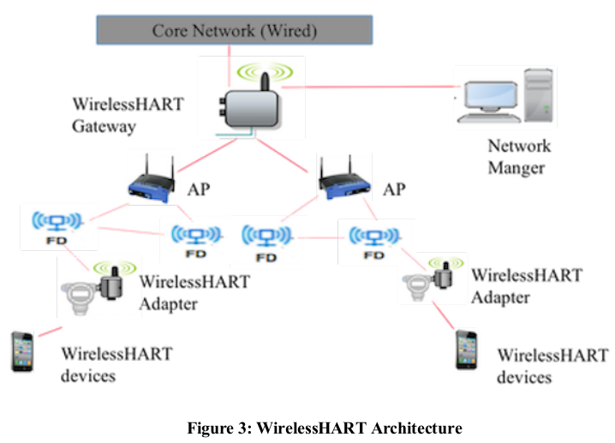
WirelessHART

Slide 49

Z-Wave
Z-Wave is a low-power MAC protocol designed for home automation and has been used for IoT communication, especially for smart home and small commercial domains. It covers about 30m point-to-point communication and is suitable for small messages in IoT applications, like light control, energy control, wearable healthcare control and others. It uses CSMA/CA for collision detection and ACK messages for reliable transmission. It follows a master/slave architecture in which the master control the slaves, send them commands, and handling scheduling of the whole network [Z-Wave].
Z-Wave is a wireless communication protocol with the frequency of 900MHz. The ranges of Z-Wave lies between 30 meters to 100 meters with the data transfer rate of 100kbps so that it is suitable for small messages in IoT applications for home automation. This communication protocol operates on mesh network architecture with one and several secondary controllers.
International standard | 800-900 MHz radio frequency range
Developed by | Zensys
Introduced | 1999
Industry | Home automation
Physical range | 100 meters

Slide 50
Z-Wave uses a source-routed mesh network architecture. Mesh networks are also known as wireless ad hoc networks. In such networks, devices use the wireless channel to send control messages which are then relayed by neighboring devices in a wave-like fashion. The source device wanting to transmit is therefore known as the initiator. Hence, the name source-initiated mesh ad hoc routing.
Properties of Z-Wave protocol
Standard: Z-Wave Alliance ZAD12837 / ITU-T G.9959
Frequency: 908.42GHz
Range: 30-100m
Data transfer rate: 100kbps
Advantages of Z-Wave protocol
Low power consumption
Remote or local control
Simple installation
Interoperability
Application of Z-Wave protocol
Smart product and IoT based application
Energy saving
Home security

Slide 51
Bluetooth
Bluetooth is a short-range wireless communication network over a radio frequency. Bluetooth is mostly integrated into smartphones and mobile devices. The Bluetooth communication network works within 2.4 ISM band frequencies with data rate up to 3Mbps.
There are three categories of Bluetooth technology:
Bluetooth Classic
Bluetooth Low Energy
Bluetooth SmartReady
The features of Bluetooth 5.0 version is introduced as Bluetooth 5 which have been developed entirely for the Internet of Things.

Slide 52
Properties of Bluetooth network
Standard: Bluetooth 4.2
Frequency: 2.4GHz
Range: 50-150m
Data transfer rates: 3Mbps
Advantages of Bluetooth network
It is wireless.
It is cheap.
It is easy to install.
It is free to use if the device is installed with it.
Disadvantages of Bluetooth network
It is a short-range communication network.
It connects only two devices at a time.

Slide 53
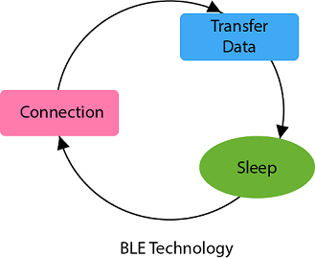
Bluetooth Low Energy
Bluetooth low energy or Bluetooth smart is a short range communication protocol with PHY and MAC layer widely used for in-vehicle networking. Its low energy can reach ten times less than the classic Bluetooth while its latency can reach 15 times. Its access control uses a contention-less MAC with low latency and fast transmission. It follows master/slave architecture and offers two types of frames: adverting and data frames. The Advertising frame is used for discovery and is sent by slaves on one or more of dedicated advertisement channels. Master nodes sense advertisement channels to find slaves and connect them. After connection, the master tells the slave it’s waking cycle and scheduling sequence. Nodes are usually awake only when they are communicating and they go to sleep otherwise to save their power.

Slide 54
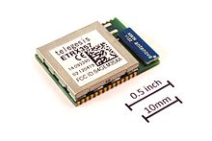
Zigbee
Zigbee is an IEEE 802.15.4-based specification for a suite of high-level communication protocols used to create personal area networks with small, low-power digital radios, such as for home automation, medical device data collection, and other low-power low-bandwidth needs, designed for small scale projects which need wireless connection. Hence, Zigbee is a low-power, low data rate, and close proximity (i.e., personal area) wireless ad hoc network.
A Zigbee module
International standard | IEEE 802.15.4
Developed by | Zigbee Alliance^{[1]}
Industry | Industrial, scientific, medical, and IoT
Physical range | 10 to 20 meters

Slide 55
The technology defined by the Zigbee specification is intended to be simpler and less expensive than other wireless personal area networks (WPANs), such as Bluetooth or more general wireless networking such as Wi-Fi. Applications include wireless light switches, home energy monitors, traffic management systems, and other consumer and industrial equipment that requires short-range low-rate wireless data transfer.
Its low power consumption limits transmission distances to 10–100 meters line-of-sight, depending on power output and environmental characteristics.^{[2]} Zigbee devices can transmit data over long distances by passing data through a mesh network of intermediate devices to reach more distant ones. Zigbee is typically used in low data rate applications that require long battery life and secure networking (Zigbee networks are secured by 128 bit symmetric encryption keys.) Zigbee has a defined rate of 250 kbit/s, best suited for intermittent data transmissions from a sensor or input device.

Slide 56
Zigbee Smart Energy
ZigBee smart energy is designed for a large range of IoT applications including smart homes, remote controls and healthcare systems. It supports a wide range of network topologies including star, peer-to-peer, or cluster-tree.
A coordinator controls the network and is the central node in a star topology, the root in a tree or cluster topology and may be located anywhere in peer-to-peer. ZigBee standard defines two stack profiles: ZigBee and ZigBee Pro.
These stack profiles support full mesh networking and work with different applications allowing implementations with low memory and processing power. ZigBee Pro offers more features including security using symmetric-key exchange, scalability using stochastic address assignment, and better performance using efficient many-to-one routing mechanisms.
ZigBee is a low power, low data rate wireless personal area network communication protocol. It is mostly used in home automation and industrial settings. Since ZigBee is a low power communication protocol, the IoT power devices used with ZigBee technology. The ZigBee communication protocol is based on the IEEE 802.15.4 standard operating at the 2.4GHz frequency. The ZigBee protocol supports star, cluster or wireless mesh technology topology.

Slide 57
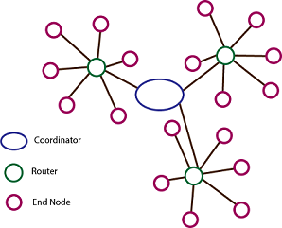
ZigBee uses the following devices in its network:
Zigbee Coordinator
Zigbee End Device
Zigbee Router

Slide 58
Properties of ZigBee protocol
Standard: ZigBee 3.0 based on IEEE802.15.4
Frequency: 2.4GHz
Range: 10-100m
Data transfer rate: 250kbps
Advantages of ZigBee protocol
Wireless
Mesh networking
Direct communication
Low power consumption
Disadvantages of ZigBee protocol
Costly
Works with low speed within a small distance
Application of ZigBee protocol
Commercial and residential control
Personal and healthcare
Home networking
Industrial control and management
Consumer electronics

Slide 59
DASH7
DASH7 is a wireless communication protocol for active RFID that operates in globally available Industrial Scientific Medical (ISM) band and is suitable for IoT requirements. It is mainly designed for scalable, long range outdoor coverage with higher data rate compared to traditional ZigBee. It is a low-cost solution that supports encryption and IPv6 addressing. It supports a master/slave architecture and is designed for burst, lightweight, asynchronous and transitive traffic. Its MAC layer features can be summarized as follows:
Filtering: Incoming frames are filtered using three processes; cyclic redundancy check (CRC) validation, a 4-bit subnet mask, and link quality assessment. Only the frames that pass all three checks are processed further.
Addressing: DASH7 uses two types of addresses: the unique identifier which is the EUI-64 ID and dynamic network identifier which is 16-bit address specified by the network administrator.
Frame format: The MAC frame has a variable length of maximum 255 bytes including addressing, subnets, estimated power of the transmission and some other optional fields.

